Slide 1
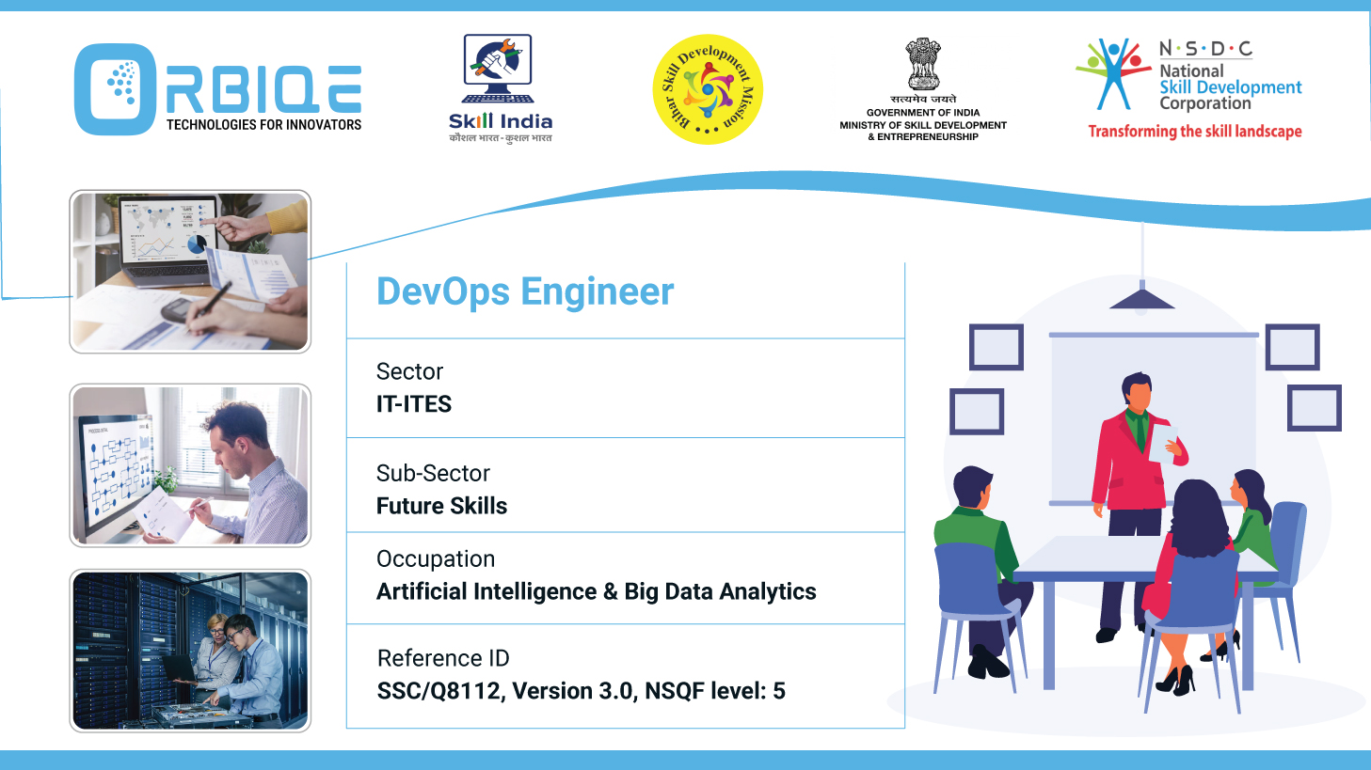
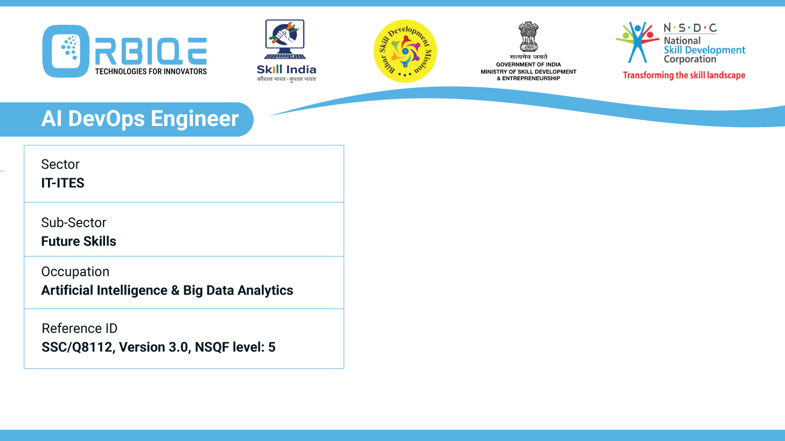
Name- Krishna Kant Dubey

Slide 2

Maintenance Marvel: Procedures and Automation for Database Health

Slide 3
Agenda
Apply different maintenance procedures and back-up routines for databases, and automate suitable processes, ensuring the ongoing health and performance of the database

Slide 4
Structured maintenance procedures and automating backup routines
Core Maintenance Procedures
Backup Routines & Automation
Automation Tools & Techniques

Slide 5
Core Maintenance Procedures
Index Management
Rebuild or Reorganize Indexes: Improve query performance by reducing fragmentation.
Automation Tip: Use SQL Server Maintenance Plans or scripts scheduled via SQL Server Agent.
Frequency: Weekly or based on fragmentation thresholds

Slide 6
Core Maintenance Procedures
Statistics Updates
Purpose: Keep query optimizer informed about data distribution.
Automation Tip: Include in maintenance plans or use in scheduled jobs.
Integrity Checks
Tool: DBCC CHECKDB for SQL Server.
Automation Tip: Schedule monthly checks to detect corruption early.

Slide 7
Core Maintenance Procedures
Performance Monitoring
Metrics: CPU, memory, disk I/O, query execution time.
Tools: MySQL Enterprise Monitor, SQL Server Profiler, Prometheus.
Automation Tip: Set alerts for threshold breaches.
Patch Management
Action: Apply updates and security patches regularly.
Automation Tip: Use configuration management tools like Ansible or WSUS for scheduling.

Slide 8
Backup Routines & Automation
Backup Types
Type | Description | Frequency
Full Backup | Entire Backup | Weekly
Differential | Changes since last full Backup | Daily
Log Backup | Transaction Logs | Every 15 Mins

Slide 9
Backup Routines & Automation
Automation Strategies
SQL Server: Use Maintenance Plans via SSMS to automate full, differential, and log backups.
MySQL: Use , MySQL Enterprise Backup, or third-party tools with cron jobs.
Backup Validation: Automate integrity checks post-backup to ensure recoverability.

Slide 10
Backup Routines & Automation
Storage & Retention
Store backups off-site or in cloud (e.g., AWS S3, Azure Blob).
Set retention policies (e.g., expire backups after 10 days).

Slide 11
Automation Tools & Techniques
Tool | Use Case | Automation Feature
SQL Server Agent | Task scheduling | Automate backups, index rebuilds
SSMS Maintenance Plans | SQL Server maintenance | GUI-based automation setup
MySQL Enterprise Monitor | Performance & health checks | Alerts and automated diagnostics
Ansible/Chef/Puppet | Patch and config management | Scripted updates and rollouts
Cron Jobs (Linux) | MySQL/PostgreSQL backups | Time-based task automation

Slide 12
Thank You

